Slide 1
The Economics and Computer Science of a Radio Spectrum Reallocation
Paul Milgrom
Stanford University & Auctionomics

Slide 2
The Reallocation Problem
National broadband plan (2010)
  Growing demand for radio spectrum capacity for mobile broadband and related services.
  Shrinking value of licenses used for over-the-air TV broadcasts.
  Efficient to reallocate between uses.
Simple market solutions insufficient
  International coordination of frequency uses.
  Different license rights for broadcast versus broadband.
  Need to move non-sellers and provide guard bands.
  Computational challenges in reassigning channels.

Slide 3
Completed April 2017
Policy: The Incentive Auction
Spectrum:
  Cleared fourteen TV channels 38-51 (84MHz).
  70MHz for use in mobile broadband
  14MHz for unlicensed uses.
Money:
  Gross revenues of $19.8 billion
  175 winning broadcasters received $10.05 billion
  Highest price was $304 million
  KQED received $95 million
  11 public TV stations received more than $100 million each

Slide 4
Topics for Today
Property rights and the hold-out problem
Computational complexity and its consequences
Ease of bidding
Algorithm performance
Market clearing

Slide 5
Hold-out problem
Goal: Suppose the FCC wishes to clear channels 38-51 of TV broadcasters to reassign to mobile broadband use.
Hold-out problem: If each broadcaster could refuse to sell its channel and if each channel interferes with adjacent channels, then each broadcaster in each single city could block reassignment of three channels nationwide.
Solution: The 2012 Act gives broadcasters the right to continue broadcasting on some channel with no increase in interference, but not to remain on the current channel.

Slide 6
complexity
Radio interference

Slide 7
The TV Study
OET-69 Bulletin Coverage:
≈10 million cells (1km x 1km )

Slide 8
Product Definition
What to buy?
Right to increase interference?
Full broadcast rights?

Slide 9
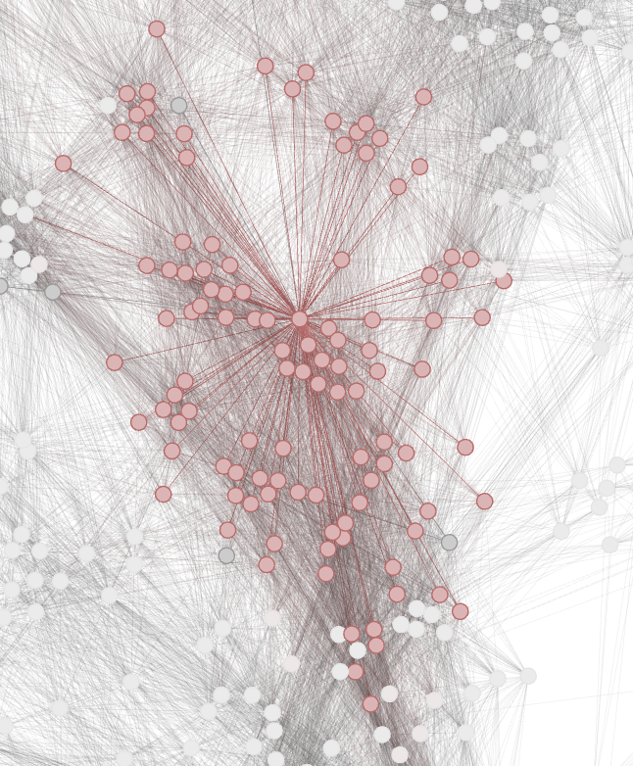
Complexity: Co-Channel Interference
Each node is a UHF-TV station.
Each arc is a pair of stations that cannot be both assigned to the same channel.
Nodes connected to the blue node are colored in pink.

Slide 10
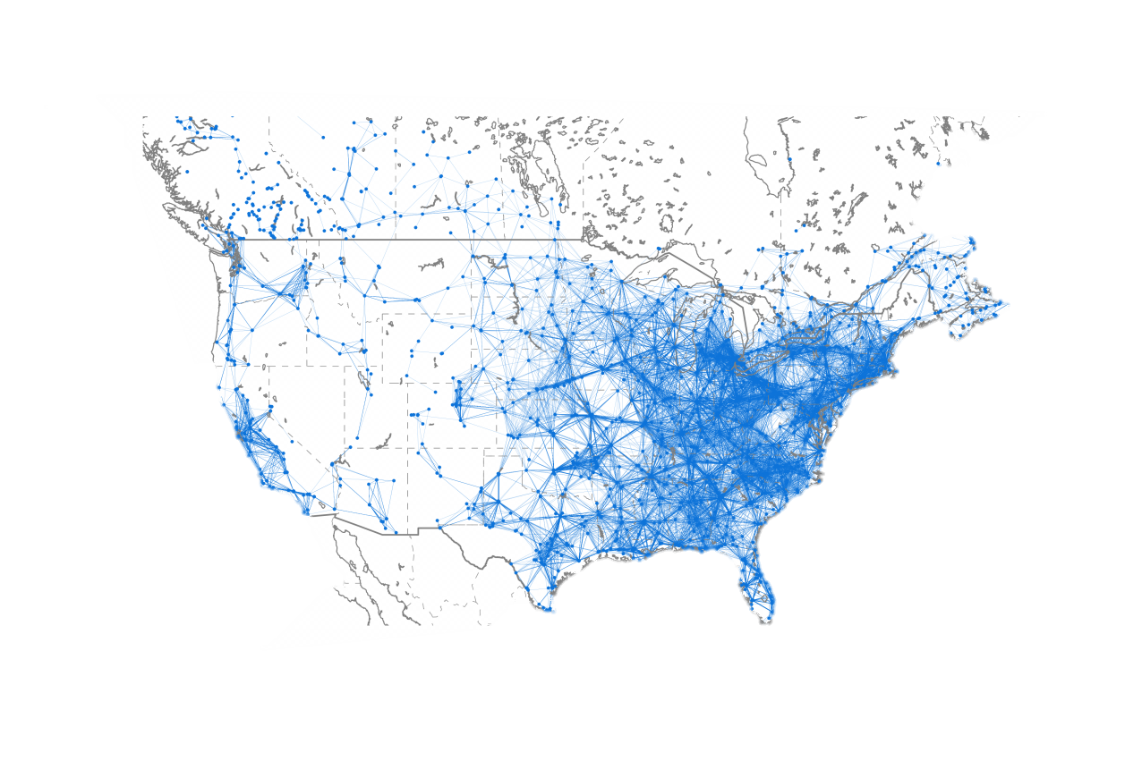
Co-Channel Interference Graph
About 130,000 co-channel constraints shown in the graph.
  Graph coloring is an NP-complete problem.
Actual constraints depend on stations and channels.
  About 2.7 million constraints in the full list.

Slide 11
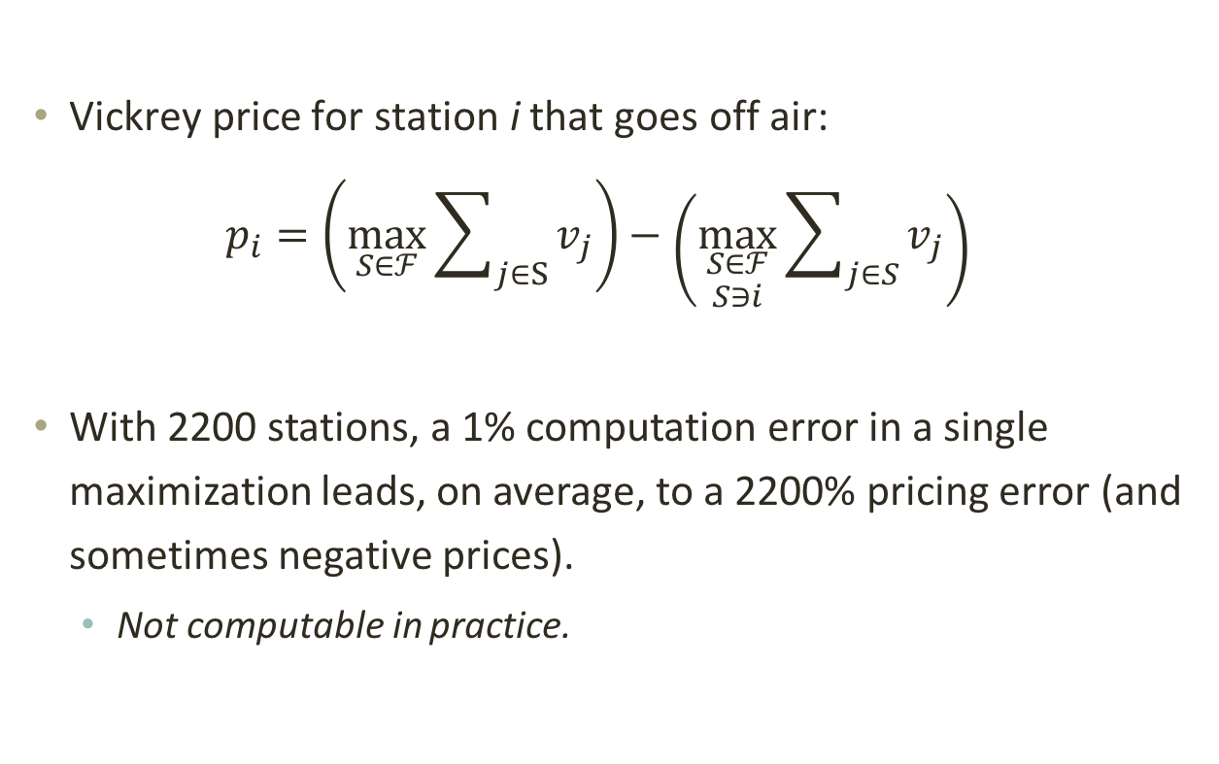
Complexity and Auction Rules
Vickrey Auction Computations
Vickrey price for station i that goes off air:
$$p_{i}=\left(\max_{S∈ℱ}{\sum_{j∈S}{v_{j}}}\right)−\left(\max_{\begin{aligned}S∈ℱ \\ S∋i\end{aligned}}{\sum_{j∈S}{v_{j}}}\right)$$
With 2200 stations, a 1% computation error in a single maximization leads, on average, to a 2200% pricing error (and sometimes negative prices).
  Not computable in practice.

Slide 12
Ease of bidding
Encouraging participation & minimizing errors

Slide 13
Bidder Trust and Experience
Dear Mr. Broadcaster:
We have heard your concerns about the complexity of the spectrum reallocation process. You may even be unsure about whether to participate or how much to bid. To make things as easy as possible for you, we have adopted a Nobel-prize winning auction procedure called the “Vickrey auction.”
In this auction, all you need to do is to tell us what your broadcast rights are worth to you. We’ll figure out whether you are a winner and, if so, how much to pay to buy your rights. The rules will ensure that it is in your interest to report truthfully. That is the magic of the Vickrey auction!
The computations that we do will be very hard ones, and we cannot guarantee that they will be exactly correct. Also, federal law forbids us to share the information that you would need to check them.
We take your trust very seriously, and we will make the best computations possible!

Slide 14
Deferred acceptance auctions
Replacing the Vickrey Auction

Slide 15
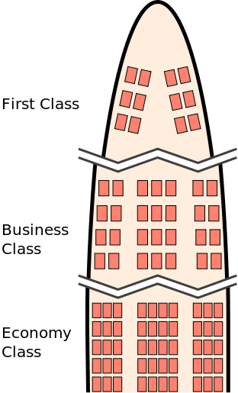
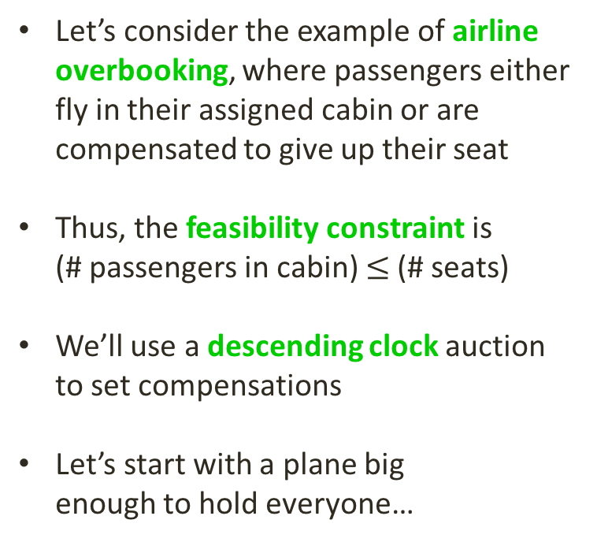
Thank you to Kevin Leyton-Brown for sharing these slides!
Airline Overbooking Problem
Let’s consider the example of airline overbooking, where passengers either fly in their assigned cabin or are
compensated to give up their seat
Thus, the feasibility constraint is
(# passengers in cabin) $≤$ (# seats)
We’ll use a descending clock auction to set compensations
Let’s start with a plane big
enough to hold everyone…

Slide 16
Reverse Auction: Descending Clock
The airline substitutes
a smaller plane and opens the bidding with a high initial compensation offer.
$1,000

Slide 17
Reverse Auction: Descending Clock
$1,000

Slide 18
Reverse Auction: Descending Clock
$800

Slide 19
Reverse Auction: Descending Clock
$800

Slide 20
Reverse Auction: Descending Clock
$800
$600

Slide 21
Reverse Auction: Descending Clock
$800
$600

Slide 22
Reverse Auction: Descending Clock
$800
$500

Slide 23
Reverse Auction: Descending Clock
$800
$500

Slide 24
Reverse Auction: Descending Clock
$800
$500
$400

Slide 25
Reverse Auction: Descending Clock
$800
$500
$400

Slide 26
Reverse Auction: Descending Clock
$800
$500
$300

Slide 27
Reverse Auction: Descending Clock
$800
$500
$300

Slide 28
Reverse Auction: Descending Clock
$800
$500
$250

Slide 29
Reverse Auction: Descending Clock
$800
$500
$250

Slide 30
Reverse Auction: Descending Clock
$800
$500
$250

Slide 31
Reverse Auction: Descending Clock
$800
New York
$500
LA
$250
Midwest

Slide 32
from Theory to practice
Applying the theory

Slide 33
Spectrum Application
No multiple reductions: Prices are reduced one-at-a-time to stations (so no “overshooting”).
Much more complicated constraints, different for each station.
Theorem: If the constraints describe a matroid, then the auction algorithm identifies the optimal allocation.
Variations: different prices can be offered to different stations, depending on characteristics and the full history of bids.
Theorem: Every variation of the auction is “obviously strategy proof” in the sense of Li (2015).
Theorem: The auction is weakly group strategy-proof.
Coming up…
  Feasibility checking is NP-complete. Strategies to resolve.
  Performance: With the actual constraints and “scoring,” the auction performs well in simulations.

Slide 34
Accelerating “Graph Coloring”
Combining Five Strategies
[Work for Auctionomics by Kevin Leyton-Brown]
Pre-identifying “unconstrained stations” to decompose the interference graph into smaller graphs to be solved separately.
Training a parameterized heuristic (“CLASP”) using machine learning to run fast on instances generated by simulations.
Creating a portfolio of algorithms with run times that time-out on “largely disjoint” sets of of instances.
Including a “local solver” in the portfolio
Including in the portfolio a searchable cache of problem components with known solutions.

Slide 35
The Generalization: “Scoring”
Theorem: There is a one-to-one mapping between deferred acceptance auctions (descending clock auctions) and “greedy rejection heuristics.”
  Idea: central “clock” shows the current score. Price on each individual bidder clock corresponds to that score.
  Station score at any point in the auction may depend on station characteristics and history of exits up to that point.
FCC station score = Population^{0.5} x Links^{0.5}.
  Links contributes to algorithm efficiency (“knapsack problem”)
  Population links price offer to “Myerson virtual value”

Slide 36
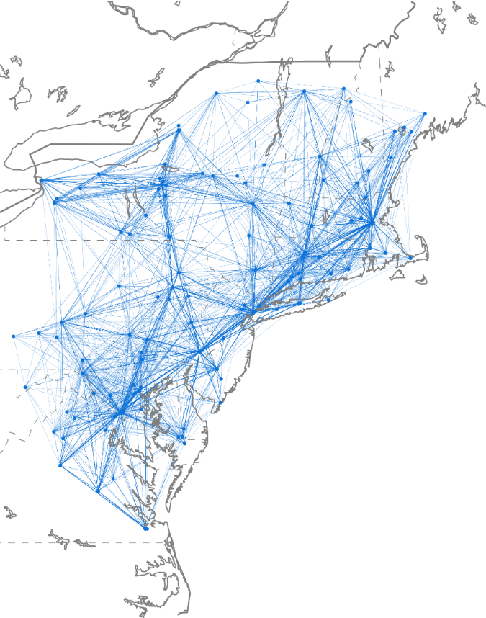
Does The Algorithm Work Well?
  Since we cannot compute VCG on national-scale problems
  Restrict attention to all stations within
  two links of New York City
    a very densely connected region
    218 stations met this criterion
Reverse auction simulator (UHF only)
Simulation assumptions:
  100% participation
  126 MHz clearing target
  valuations generated by sampling from a prominent model due FCC chief economist (before her FCC appointment)
  1 min timeout given to SATFC

Slide 37
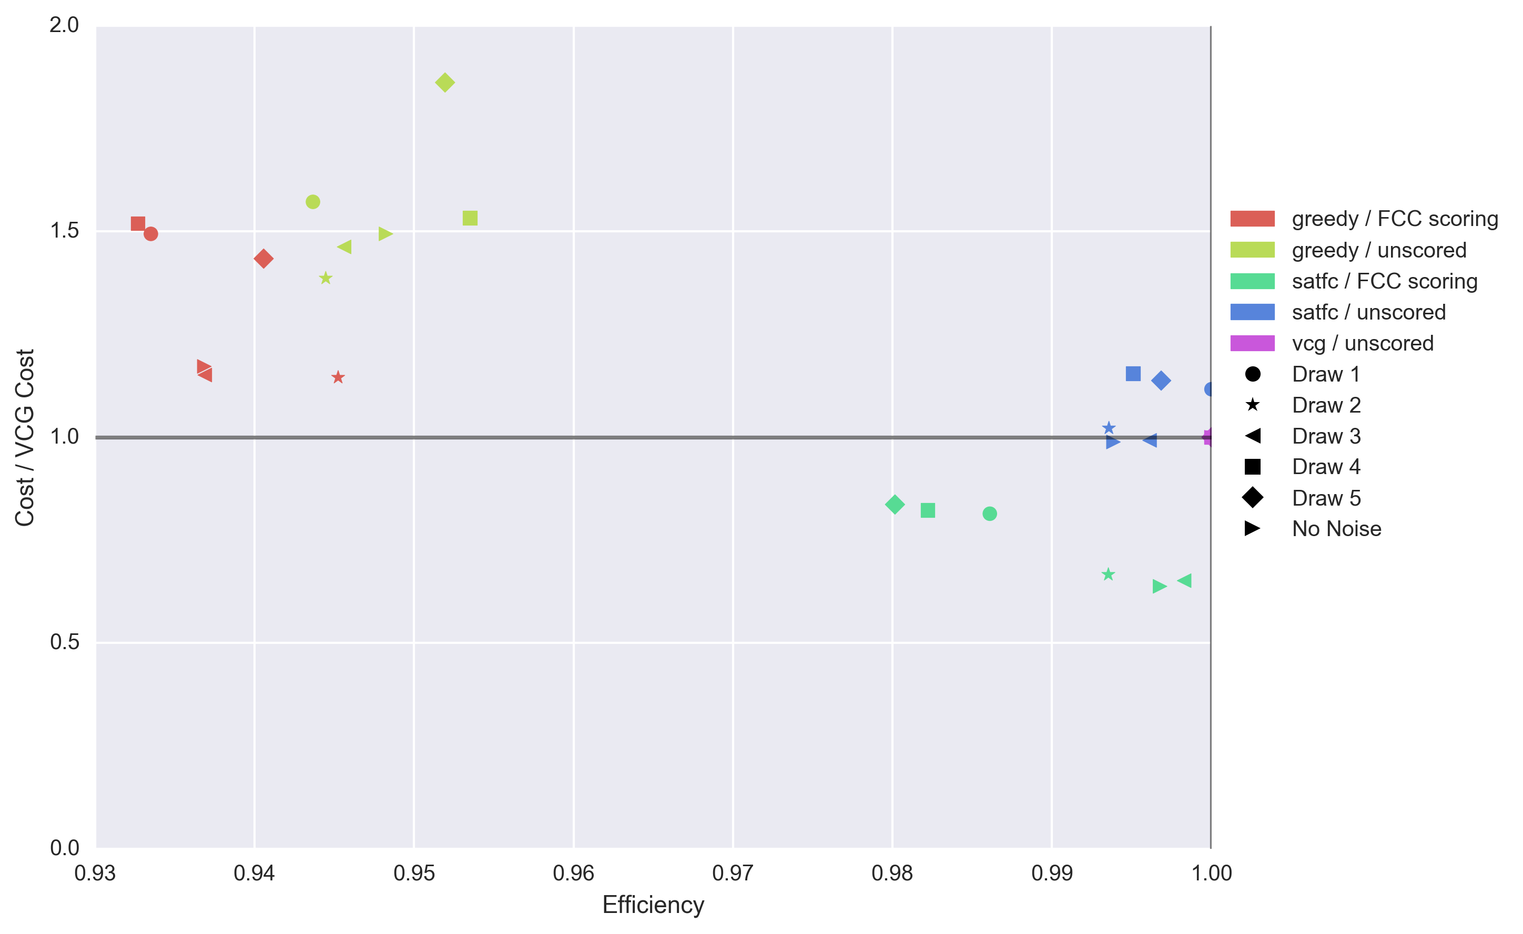
Performance of Incentive Auction Algorithms
“Greedy”: check whether
existing solution can be
directly augmented with
new station

Slide 38
“Marshallian” Market Clearing Algorithm
Descending clock stopping rule: Stops for a station when it either has exited or must be cleared to achieve the clearing target. (The stage ends when all clocks have stopped.)
Maximum Opening Bids
Reverse Auction
Initial
spectrum clearing target (# channels)
Closing rule
met?
Reduce spectrum clearing target, continue auctions
No
Forward Auction
Yes
Ascending clock stopping rule: Stops for a license category when there is no excess demand for that category. (The stage ends when all clocks have stopped.)
Close Auction
Reverse auction: frozen bids accepted; channels assigned
Forward auction: assignment stage for specific frequencies
Minimum Opening Bids

Slide 39
The end

Slide 40
“Approximate matroids”
The Substitution Index

Slide 41
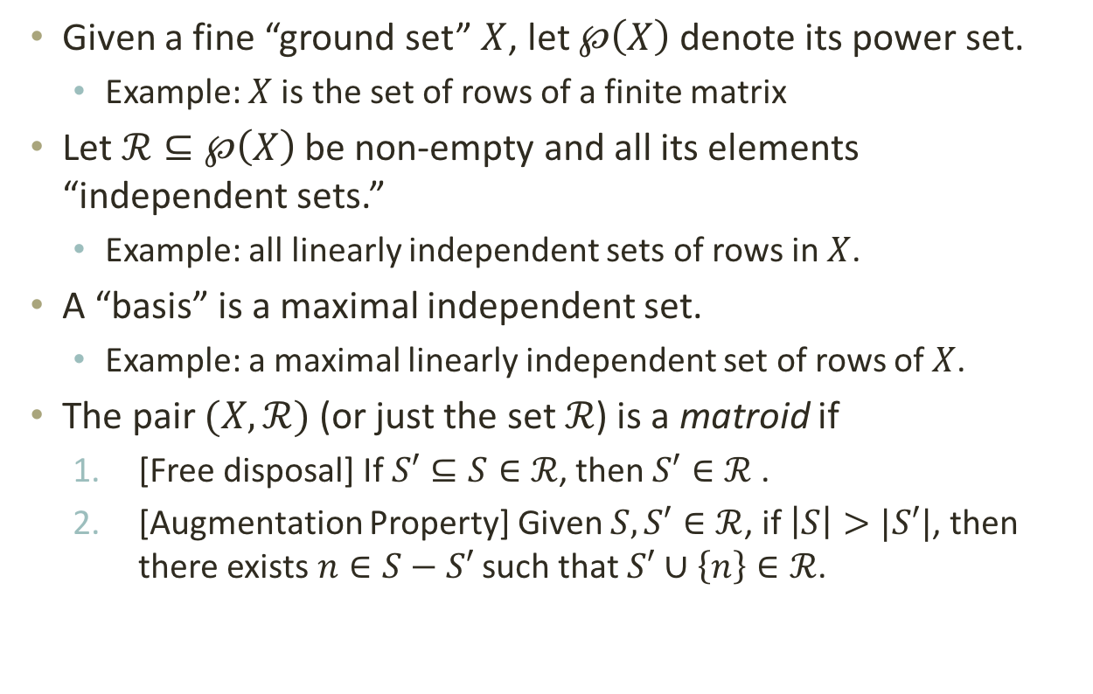
Matroid Terms Defined
Given a fine “ground set” $X$, let $℘\left(X\right)$ denote its power set.
  Example: $X$ is the set of rows of a finite matrix
Let $ℛ⊆℘\left(X\right)$ be non-empty and all its elements “independent sets.”
  Example: all linearly independent sets of rows in $X$.
A “basis” is a maximal independent set.
  Example: a maximal linearly independent set of rows of $X$.
The pair $(X,ℛ)$ (or just the set $ℛ$) is a matroid if
  [Free disposal] If $S′⊆S∈ℛ$, then $S′∈ℛ$ .
  [Augmentation Property] Given $S,S′∈ℛ$, if $\left|S\right|>|S′|$, then there exists $n∈S−S′$ such that $S′∪\left\{n\right\}∈ℛ$.

Slide 42
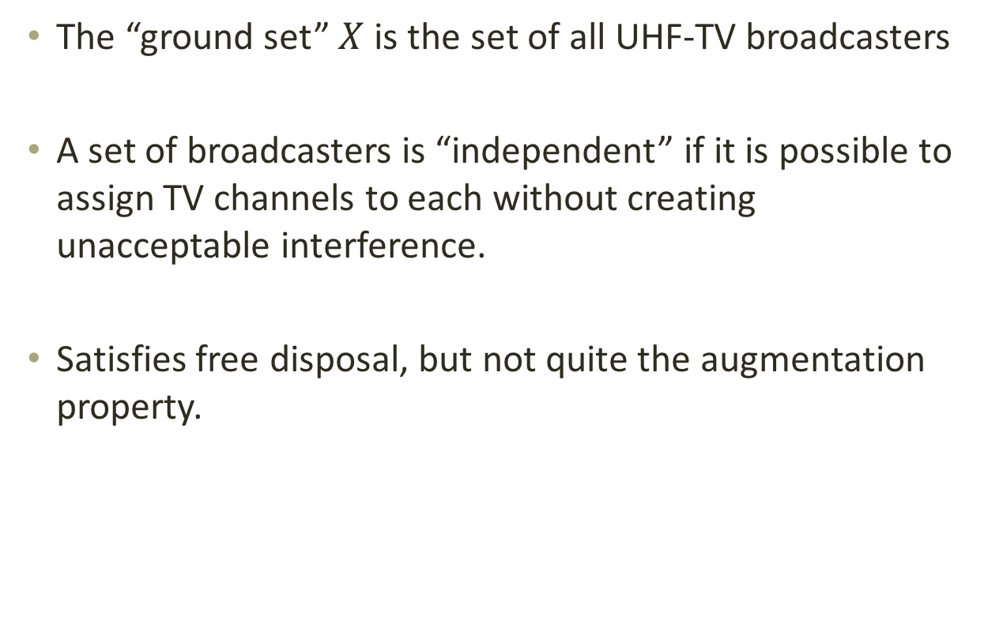
Idealized Application
  The “ground set” $X$ is the set of all UHF-TV broadcasters
  A set of broadcasters is “independent” if it is possible to assign TV channels to each without creating unacceptable interference.
  Satisfies free disposal, but not quite the augmentation property.

Slide 43
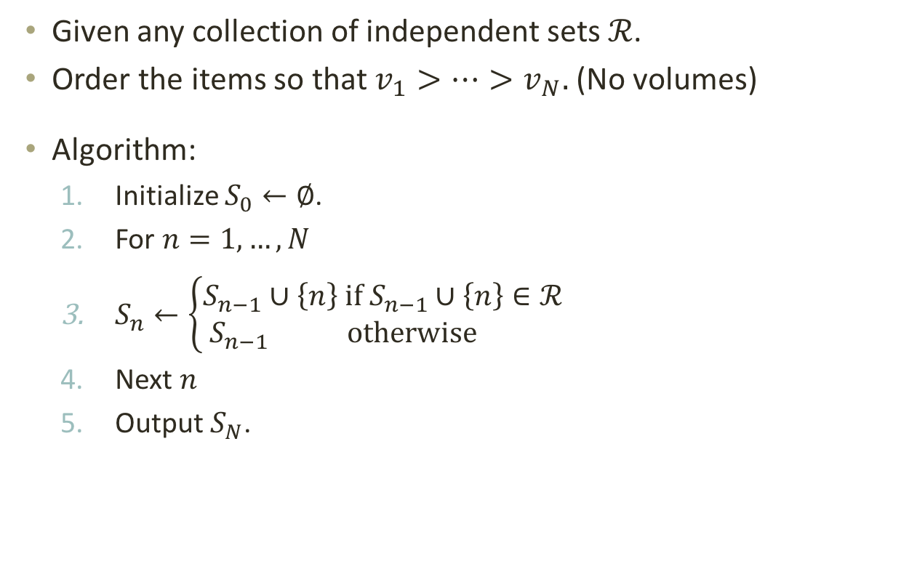
Greedy Algorithm
Given any collection of independent sets $ℛ$.
Order the items so that $v_{1}>…>v_{N}.$ (No volumes)
Algorithm:
  Initialize $S_{0}←∅$.
  For $n=1,…,N$
  $S_{n}←\left\{\begin{aligned}S_{n−1}∪\left\{n\right\} if S_{n−1}∪\left\{n\right\}∈ℛ \\ S_{n−1 } otherwise \end{aligned}\right.$
  Next $n$
  Output $S_{N}$.

Slide 44
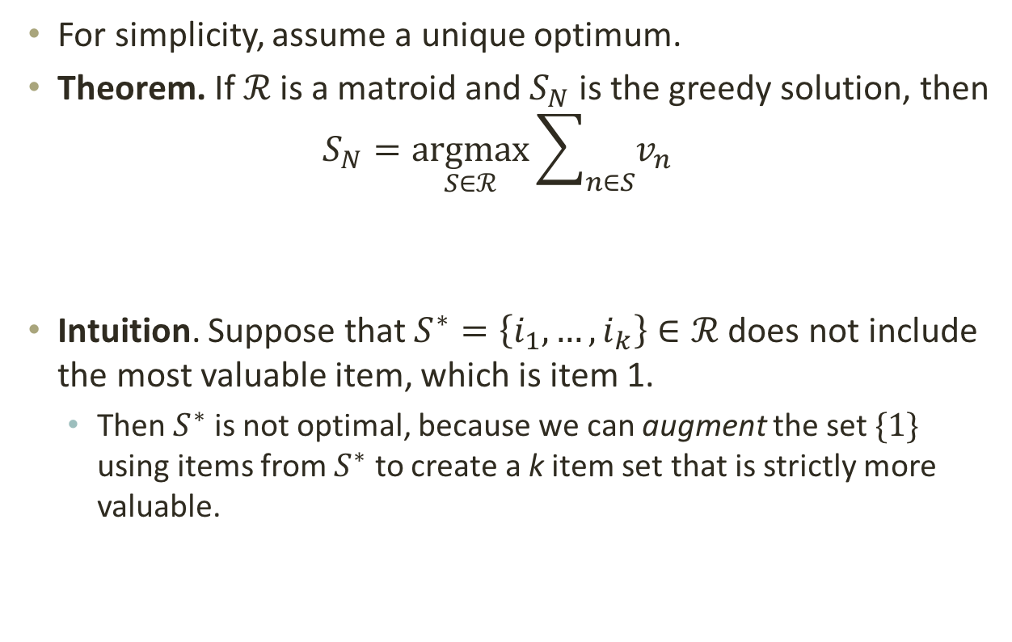
Optimization on Matroids
For simplicity, assume a unique optimum.
Theorem. If $ℛ$ is a matroid and $S_{N}$ is the greedy solution, then
$$S_{N}=\underset{S∈ℛ}{argmax}{\sum_{n∈S}{v_{n}}}$$
Intuition. Suppose that $S^{∗}=\left\{i_{1},…,i_{k}\right\}∈ℛ$does not include the most valuable item, which is item 1.
  Then $S^{∗}$ is not optimal, because we can augment the set $\{1\}$ using items from $S^{∗}$ to create a k item set that is strictly more valuable.

Slide 45
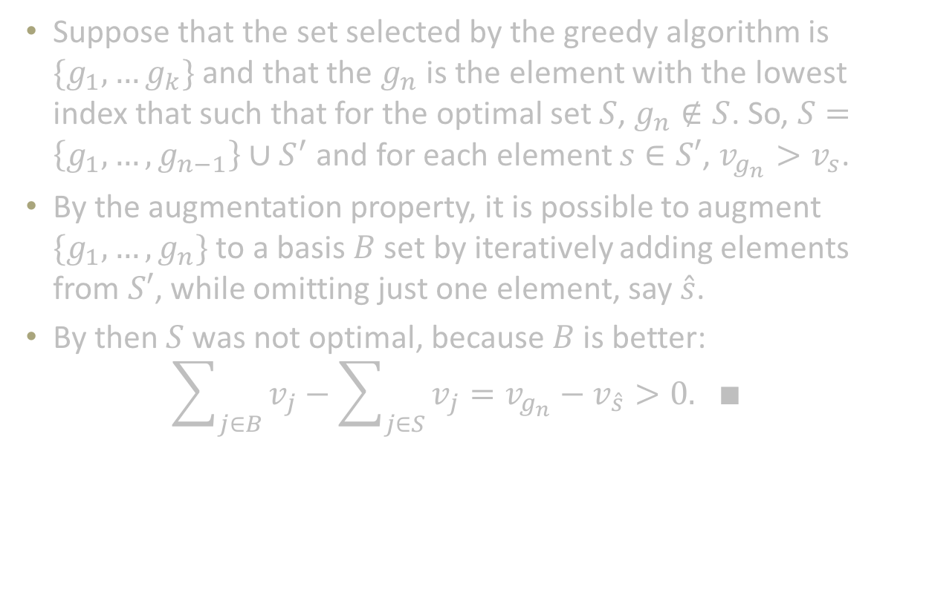
Full Proof is by Induction
Suppose that the set selected by the greedy algorithm is $\{g_{1},…g_{k}\}$ and that the $g_{n}$ is the element with the lowest index that such that for the optimal set $S$, $g_{n}∉S$. So, $S=\left\{g_{1},…,g_{n−1}\right\}∪S^{′}$ and for each element $s∈S′$, $v_{g_{n}}>v_{s}$.
By the augmentation property, it is possible to augment $\{g_{1},…,g_{n}\}$ to a basis $B$ set by iteratively adding elements from $S′$, while omitting just one element, say $\hat{s}$.
By then $S$was not optimal, because $B$ is better:
$$\sum_{j∈B}{v_{j}}−\sum_{j∈S}{v_{j}}=v_{g_{n}}−v_{\hat{s}}>0. ∎$$

Slide 46
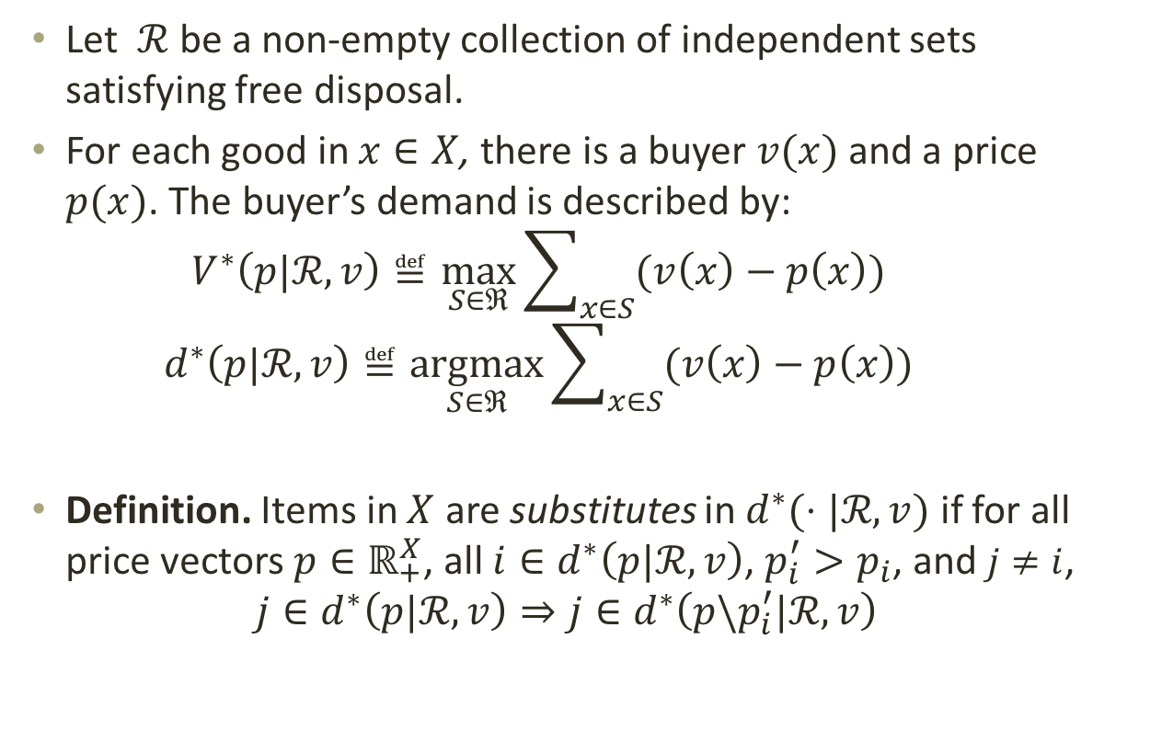
Substitutes Defined
Let $ℛ$ be a non-empty collection of independent sets satisfying free disposal.
For each good in $x∈X$, there is a buyer $v(x)$ and a price $p(x)$. The buyer’s demand is described by:
    $$V^{∗}\left(p|ℛ,v\right)≝\max_{S∈ℜ}{\sum_{x∈S}{(v\left(x\right)−p\left(x\right))}}$$
    $$d^{∗}\left(p|ℛ,v\right)≝\underset{S∈ℜ}{argmax}{\sum_{x∈S}{(v\left(x\right)−p\left(x\right))}}$$
Definition. Items in $X$ are substitutes in $d^{∗}(⋅|ℛ,v)$ if for all price vectors $p∈ℝ_{+}^{X}$, all $i∈d^{∗}\left(p|ℛ,v\right)$, $p_{i}^{′}>p_{i}$, and $j≠i$,
$${j∈d}^{∗}\left(p|ℛ,v\right)⇒{j∈d}^{∗}\left(p\backslash p_{i}^{′}|ℛ,v\right)$$

Slide 47
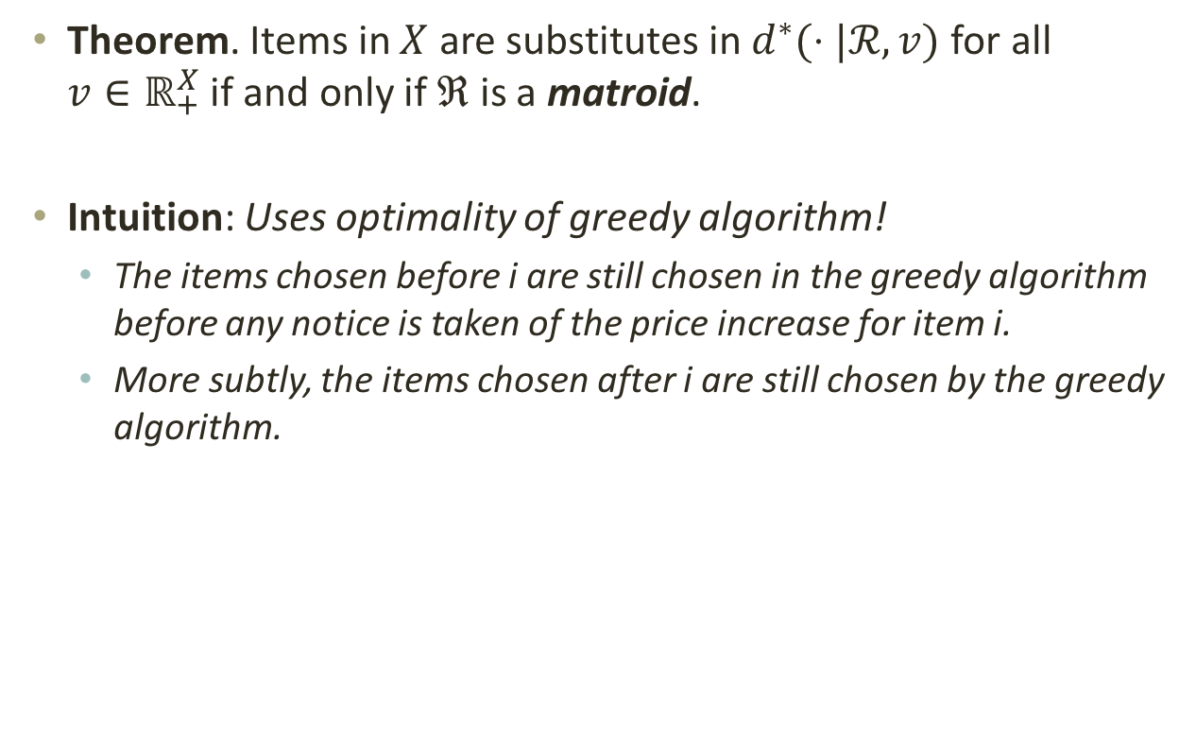
Matroids and Substitutes
Theorem. Items in $X$ are substitutes in $d^{∗}(⋅|ℛ,v)$ for all
$v∈ℝ_{+}^{X}$ if and only if $ℜ$ is a matroid.
Intuition: Uses optimality of greedy algorithm!
  The items chosen before i are still chosen in the greedy algorithm before any notice is taken of the price increase for item i.
  More subtly, the items chosen after i are still chosen by the greedy algorithm.

Slide 48
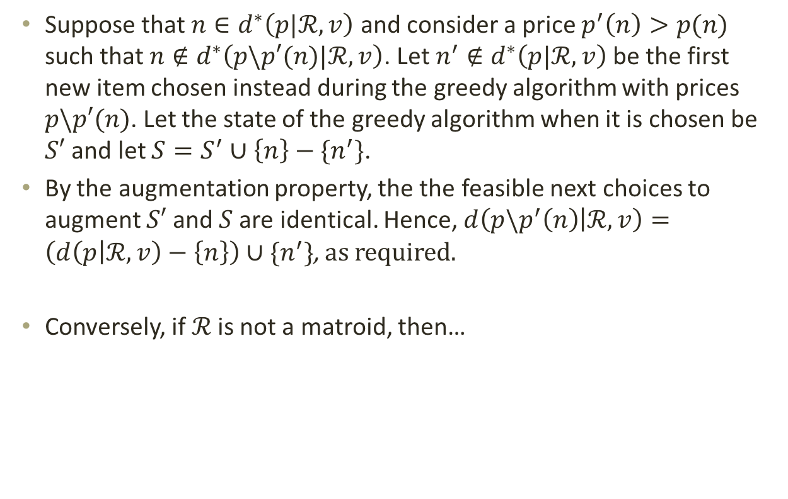
Proof Sketch
Suppose that $n∈d^{∗}\left(p|ℛ,v\right)$ and consider a price $p^{′}\left(n\right)>p(n)$ such that $n∉d^{∗}\left(p\backslash p′(n)|ℛ,v\right)$. Let $n^{′}∉d^{∗}\left(p|ℛ,v\right)$ be the first new item chosen instead during the greedy algorithm with prices $p\backslash p′(n)$. Let the state of the greedy algorithm when it is chosen be $S′$ and let $S=S^{′}∪\left\{n\right\}−\{n^{′}\}$.
By the augmentation property, the the feasible next choices to augment $S′$ and $S$ are identical. Hence, $d\left(p{\backslash p}^{′}\left(n\right) | ℛ,v\right)=\left(d\left(p | ℛ,v\right)−\left\{n\right\}\right)∪\{n^{′}\}$, as required.
Conversely, if $ℛ$is not a matroid, then…

Slide 49
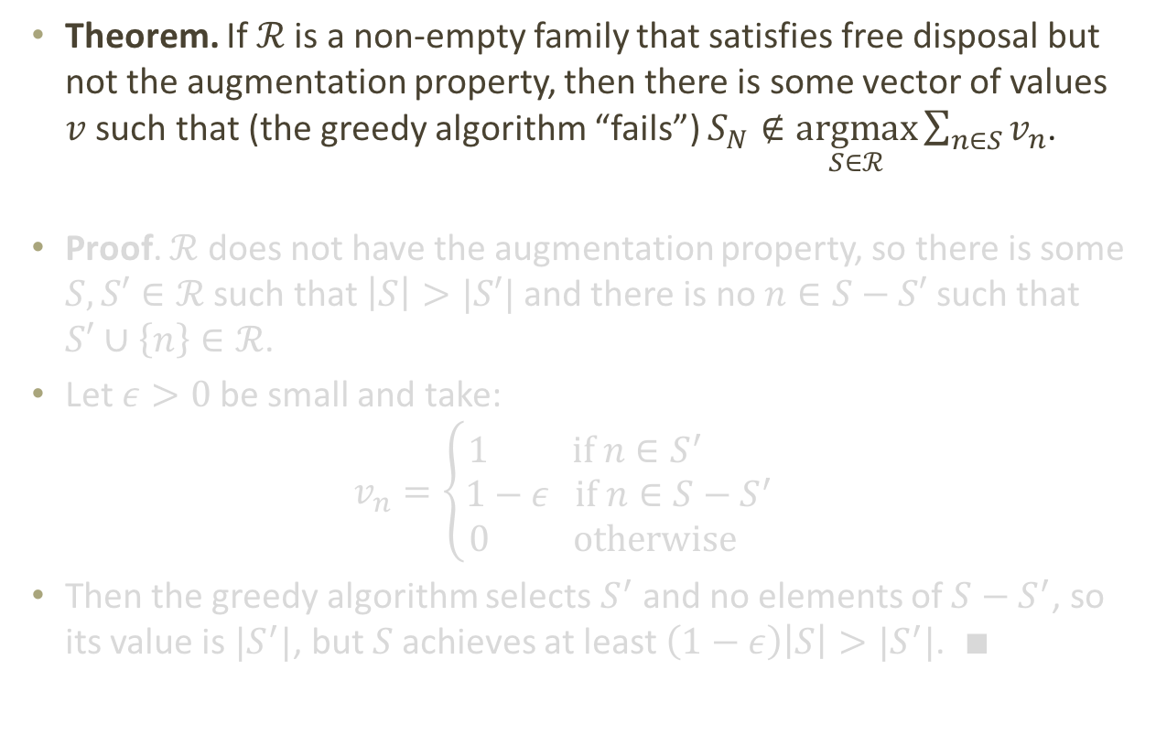
Necessity of Matroids
Theorem. If $ℛ$ is a non-empty family that satisfies free disposal but not the augmentation property, then there is some vector of values $v$ such that (the greedy algorithm “fails”) $S_{N}∉\underset{S∈ℛ}{argmax}{\sum_{n∈S}{v_{n}}}$.
Proof. $ℛ$ does not have the augmentation property, so there is some $S,S′∈ℛ$ such that $\left|S\right|>|S′|$ and there is no $n∈S−S′$ such that $S′∪\left\{n\right\}∈ℛ$.
Let $ε>0$ be small and take:
$$v_{n}=\left\{\begin{aligned}1 if n∈S^{′} \\ 1−ε if n∈S−S^{′} \\ 0 otherwise \end{aligned}\right.$$
Then the greedy algorithm selects $S^{′}$ and no elements of $S−S^{′}$, so its value is $|S^{′}|$, but $S$ achieves at least $\left(1−ε\right)\left|S\right|>|S^{′}|$. $∎$

Slide 50
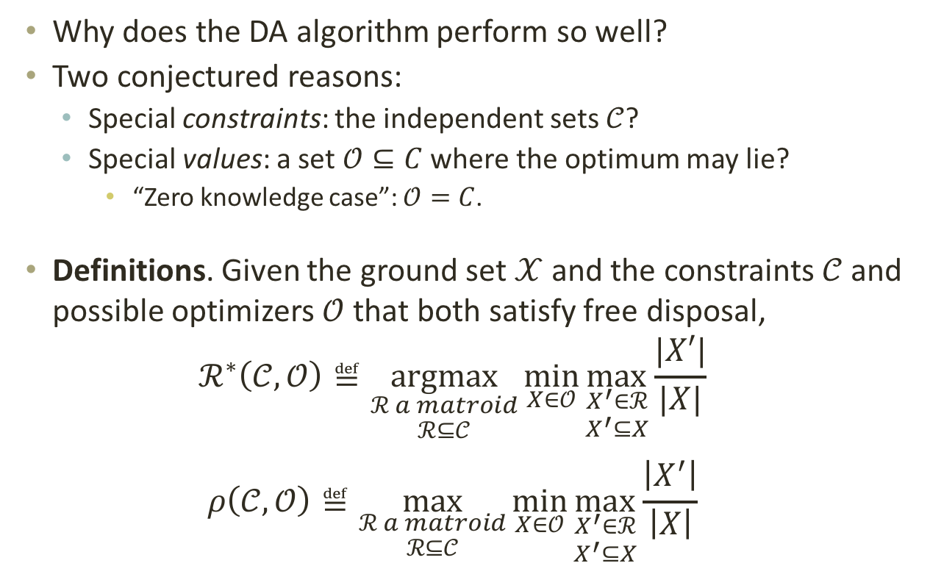
The Substitution Index
Why does the DA algorithm perform so well?
Two conjectured reasons:
  Special constraints: the independent sets $𝒞$?
  Special values: a set $𝒪⊆C$ where the optimum may lie?
    “Zero knowledge case”: $𝒪=C$.
Definitions. Given the ground set $𝒳$ and the constraints $𝒞$ and possible optimizers $𝒪$ that both satisfy free disposal,
$$ℛ^{∗}\left(𝒞,𝒪\right)≝\underset{\begin{aligned}ℛ a matroid \\ ℛ⊆𝒞\end{aligned}}{argmax}{\min_{X∈𝒪}{\max_{\begin{aligned}X^{′}∈ℛ \\ X^{′}⊆X\end{aligned}}{\frac{|X′|}{|X|}}}}$$
$$ρ\left(𝒞,𝒪\right)≝\max_{\begin{aligned}ℛ a matroid \\ ℛ⊆𝒞\end{aligned}}{\min_{X∈𝒪}{\max_{\begin{aligned}X^{′}∈ℛ \\ X^{′}⊆X\end{aligned}}{\frac{\left|X^{′}\right|}{\left|X\right|}}}}$$

Slide 51
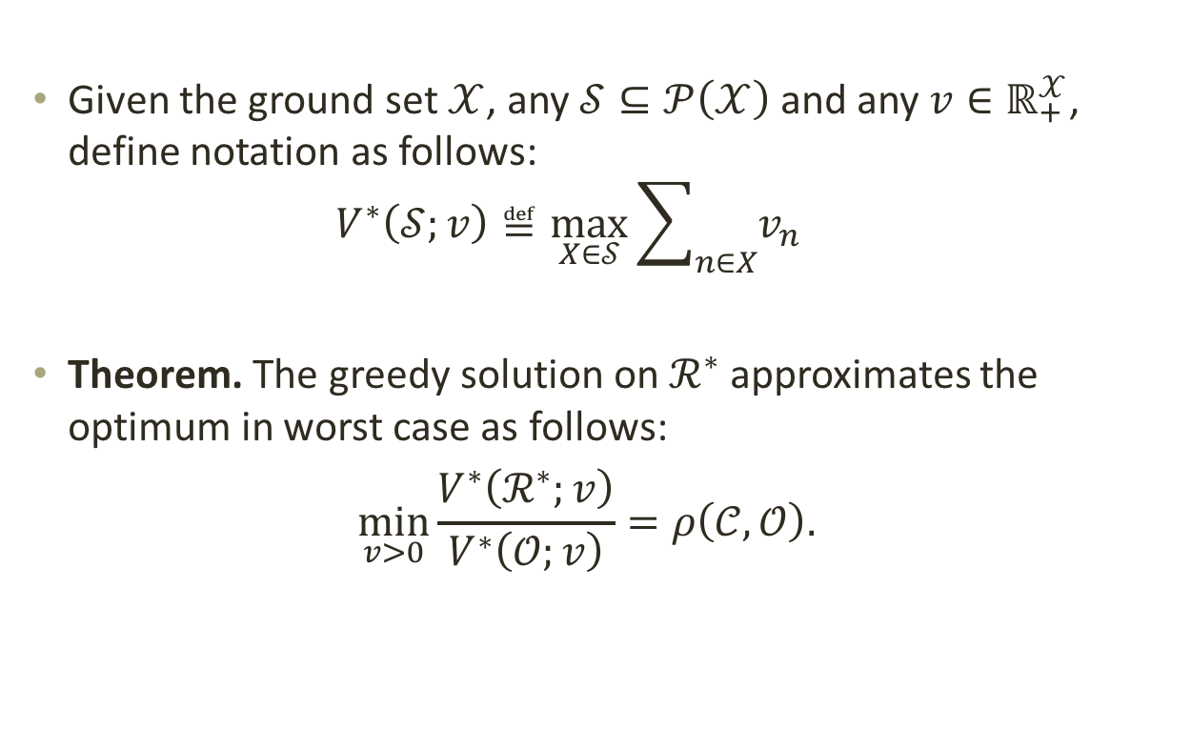
Approximation Theorem
Given the ground set $𝒳$, any $𝒮⊆𝒫\left(𝒳\right)$ and any $v∈ℝ_{+}^{𝒳}$, define notation as follows:
$V^{∗}\left(𝒮;v\right)≝\max_{X∈𝒮}{\sum_{n∈X}{v_{n}}}$
Theorem. The greedy solution on $ℛ^{∗}$ approximates the optimum in worst case as follows:
$$\min_{v>0}\frac{V^{∗}\left(ℛ^{∗};v\right)}{V^{∗}\left(𝒪;v\right)}=ρ\left(𝒞,𝒪\right).$$

Slide 52
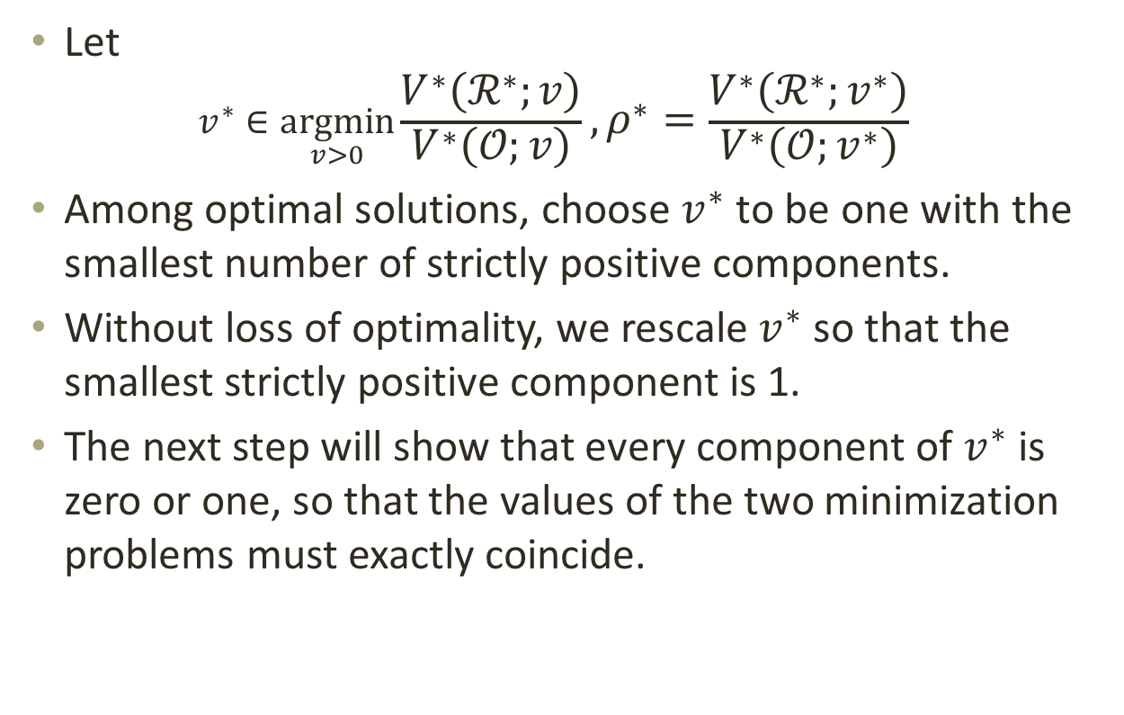
Proof Sketch, 1
Let
$v^{∗}∈\underset{v>0}{argmin}\frac{V^{∗}\left(ℛ^{∗};v\right)}{V^{∗}\left(𝒪;v\right)}, ρ^{∗}=\frac{V^{∗}\left(ℛ^{∗};v^{∗}\right)}{V^{∗}\left(𝒪;v^{∗}\right)}$
Among optimal solutions, choose $v^{∗}$ to be one with the smallest number of strictly positive components.
Without loss of optimality, we rescale $v^{∗}$ so that the smallest strictly positive component is 1.
The next step will show that every component of $v^{∗}$ is zero or one, so that the values of the two minimization problems must exactly coincide.

Slide 53
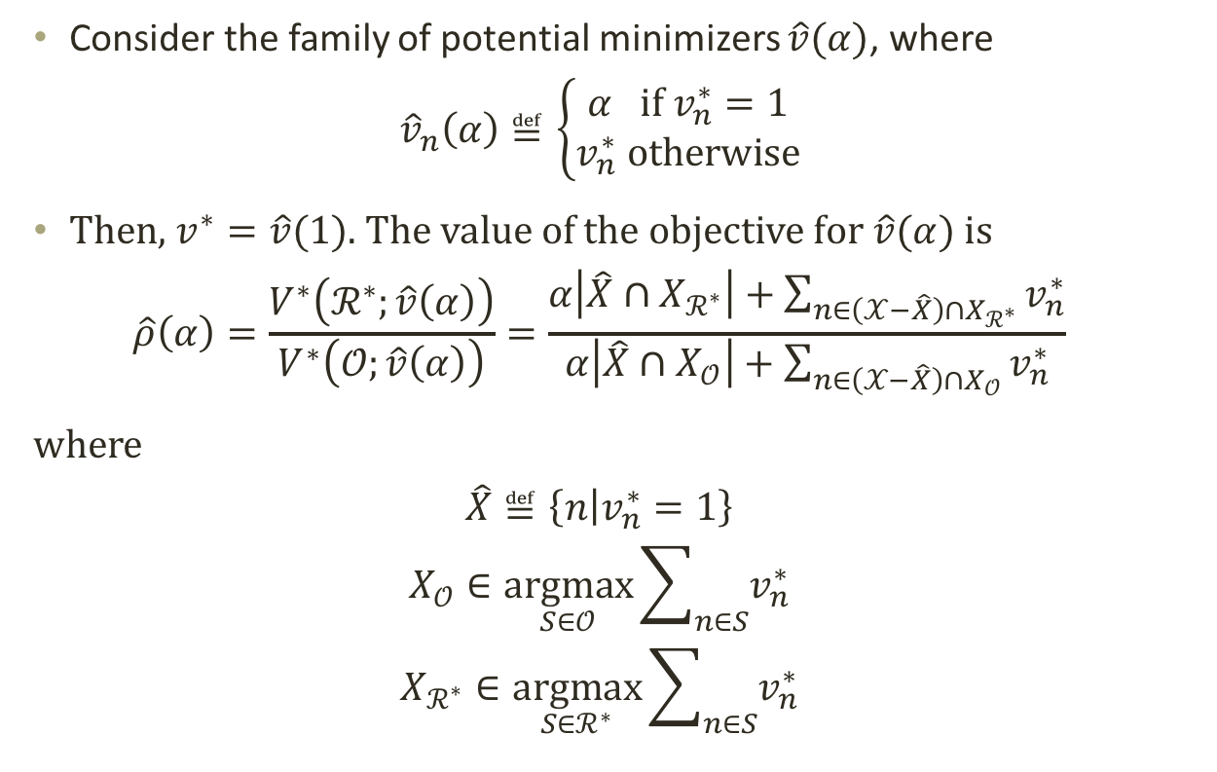
Proof Sketch, 2
Consider the family of potential minimizers $\hat{v}(α)$, where
$${\hat{v}}_{n}\left(α\right)≝\left\{\begin{aligned}α if v_{n}^{∗}=1 \\ v_{n}^{∗} otherwise\end{aligned}\right.$$
Then, $v^{∗}=\hat{v}(1)$. The value of the objective for $\hat{v}(α)$ is
$$\hat{ρ}\left(α\right)=\frac{V^{∗}\left(ℛ^{∗};\hat{v}\left(α\right)\right)}{V^{∗}\left(𝒪;\hat{v}\left(α\right)\right)}=\frac{α\left|\hat{X}{∩X}_{ℛ^{∗}}\right|+\sum_{n∈\left(𝒳−\hat{X}\right)∩X_{ℛ^{∗}}}{v_{n}^{∗}}}{α\left|\hat{X}{∩X}_{𝒪}\right|+\sum_{n∈\left(𝒳−\hat{X}\right)∩X_{𝒪}}{v_{n}^{∗}}}$$
where
$$\hat{X}≝\left\{n | v_{n}^{∗}=1\right\}$$
$$X_{𝒪}∈\underset{S∈𝒪}{argmax}{\sum_{n∈S}{v_{n}^{∗}}}$$
$$X_{ℛ^{∗}}∈\underset{S∈ℛ^{∗}}{argmax}{\sum_{n∈S}{v_{n}^{∗}}}$$

Slide 54
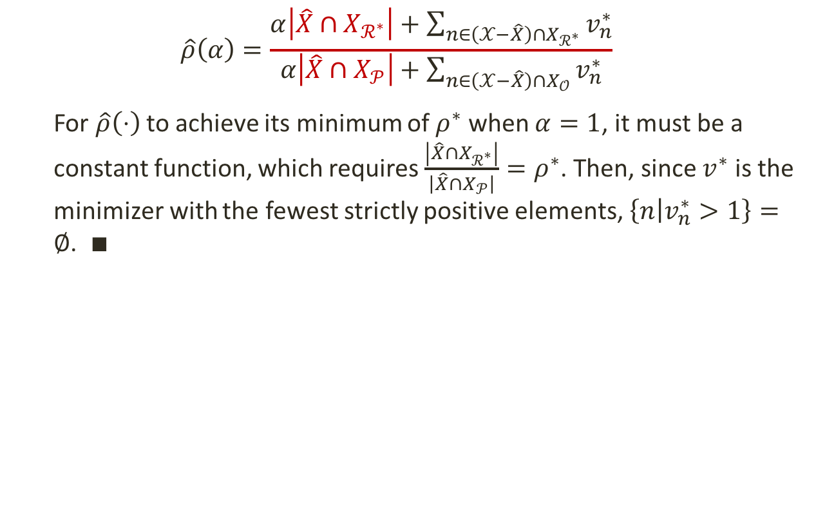
Proof Sketch, 3
$$\hat{ρ}\left(α\right)=\frac{α\left|\hat{X}{∩X}_{ℛ^{∗}}\right|+\sum_{n∈\left(𝒳−\hat{X}\right)∩X_{ℛ^{∗}}}{v_{n}^{∗}}}{α\left|\hat{X}{∩X}_{𝒫}\right|+\sum_{n∈\left(𝒳−\hat{X}\right)∩X_{𝒪}}{v_{n}^{∗}}}$$
  For $\hat{ρ}\left(⋅\right)$ to achieve its minimum of $ρ^{∗}$ when $α=1$, it must be a constant function, which requires $\frac{\left|{\hat{X}∩X}_{ℛ^{∗}}\right|}{\left|{\hat{X}∩X}_{𝒫}\right|}=ρ^{∗}$. Then, since $v^{∗}$ is the minimizer with the fewest strictly positive elements, $\left\{n | v_{n}^{∗}>1\right\}=∅$. $∎$

Slide 55
end

Slide 56
How Many Channels to Clear?
TV spectrum supply
Reverse Price
Net Revenue > Target
LOSS
Forward Price
Number of Channels

Slide 57
“Marshallian” Market Clearing Algorithm
Descending clock stopping rule: Stops for a station when it either has exited or must be cleared to achieve the clearing target. (The stage ends when all clocks have stopped.)
Maximum Opening Bids
Reverse Auction
Initial
spectrum clearing target (# channels)
Closing rule
met?
Reduce spectrum clearing target, continue auctions
No
Forward Auction
Yes
Ascending clock stopping rule: Stops for a license category when there is no excess demand for that category. (The stage ends when all clocks have stopped.)
Close Auction
Reverse auction: frozen bids accepted; channels assigned
Forward auction: assignment stage for specific frequencies
Minimum Opening Bids

Slide 58
policy: the “incentive auction”
Completed in April 2017

Slide 59
Part I: Reverse Auction
$10.05 billion | Payments to winning broadcast stations
84 MHz | Cleared by the reverse auction process
175 | Winning stations
$304 million | Largest individual station payout
$194 million | Largest non-commercial station payout
30 | Band changing winners (moved to low- or high-VHF)
36 | Winning stations receiving more than $100 million
11 | Non-commercial stations winning more than $100 million

Slide 60
Part II: Forward Auction
$19.8 billion | Gross revenues (2nd largest in FCC auction history)
$19.3 billion | Revenues net of requested bidding credits
$7.3 billion | Auction proceeds for federal deficit reduction
70 MHz | Largest amount of licensed low-band spectrum ever made available at auction
14 MHz | Spectrum available for wireless mics and unlicensed use
2,776 | License blocks sold (out of total of 2,912 offered)
$1.31 | Average price/MHz-pop sold in Top 40 PEAs
$.93 | Average price/MHz-pop sold nationwide
50 | Winning bidders
23 | Winning bidders seeking rural bidding credits
15 | Winning bidders seeking small business bidding credits

